Slide 1

SPOON&FORK
APPLICATION

Slide 2

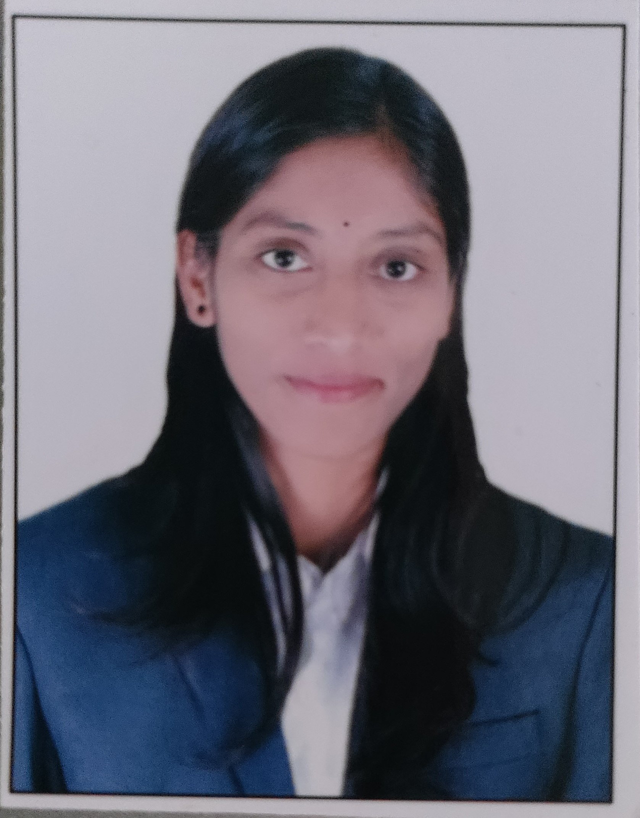
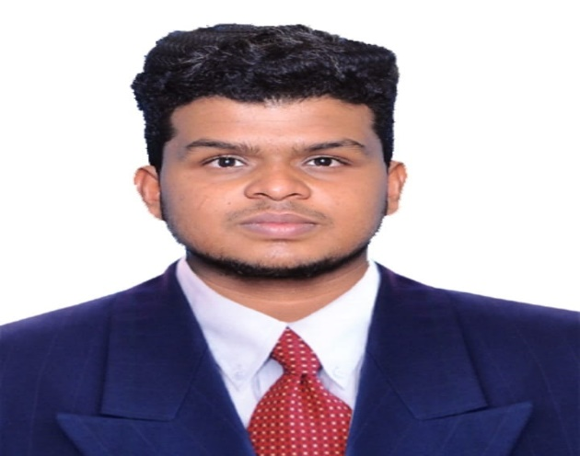
Project proposal by
Samuya patel​
sonali​
venuprasath
(B.E. ELECTRICAL ENGINEERING)
(2020)
​
(B.E. COMPUTER ENGINEERING)
(2019)
(B.E CIVIL ENGINEERING)
(2019)

Slide 3

Contents
INTRODUCTION
OBJECTIVE
TECHNOLOGIES USED
PROJECT FLOW
FUTURE ENHANCEMENT
CONCLUSION

Slide 4
Introduction

Slide 5

Objective
A food Ordering app's goals are to offer a practical and effective platform that links customers and businesses, enabling seamless food ordering and delivery services.

Slide 6
TECHNOLOGIES USED
FRONT END
.
HTML : Create web page and tells the browser to display them
CSS : Add style to web page
TYPESCRIPT : Extends java script and enhances the developer experience
ANGULAR : Refer the component which template was rendered
JAVASCRIPT : Java script make web pages dynamic

Slide 7
TECHNOLOGIES USED
BACK END
.a
JAVA : Java is a widely-used programming language for web application
SPRING BOOT
APPLICATION : Spring Boot helps developers create applications that just run.
MONGODB : MongoDB is a document database for scalable internet applications.
MY SQL :MySQL is a relational database management system

Slide 8
PROJECT FLOW

Slide 9
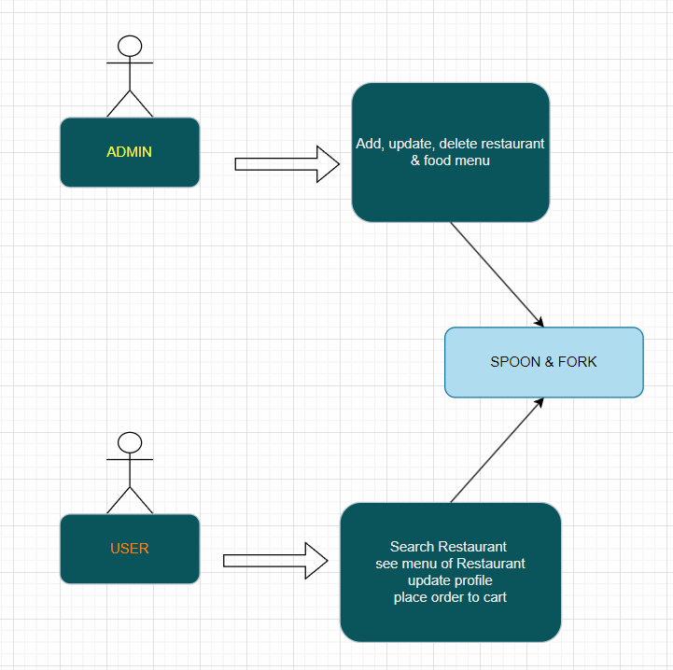

Slide 10
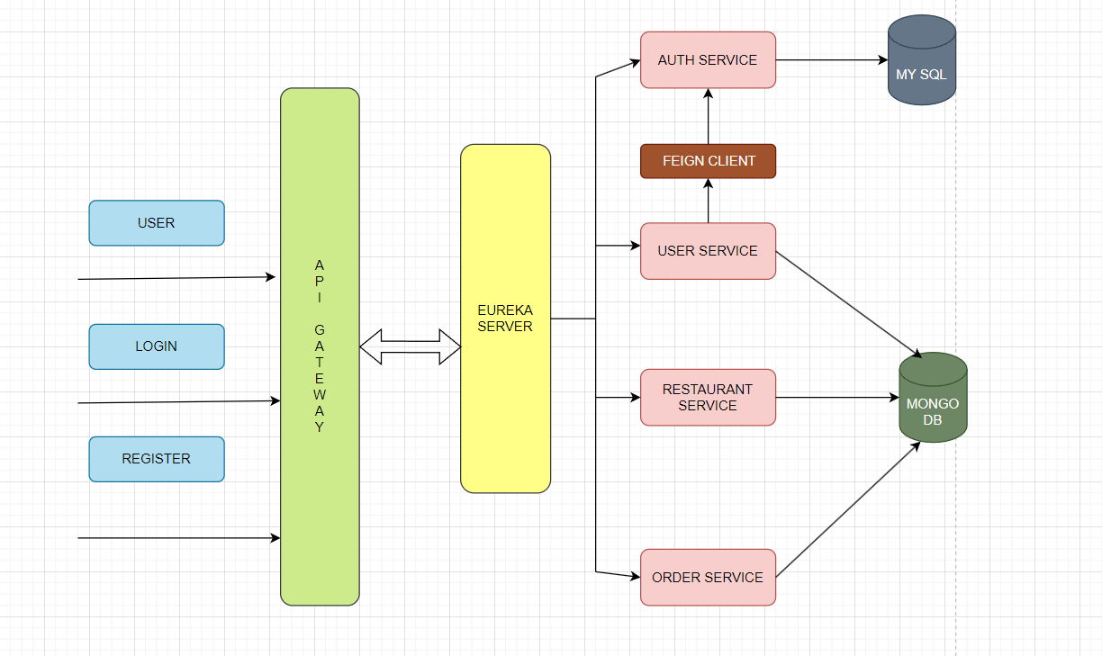
BACK END FLOW

Slide 11
The Order Service initiates the process by placing an order.
The Restaurant Service receives the order and provides order confirmation.
The Eureka Service is responsible for service discovery and registration.
The API Gateway validates and routes requests to the appropriate services.
The authentication service can be integrated into the API Gateway to ensure secure access to the services.

Slide 12
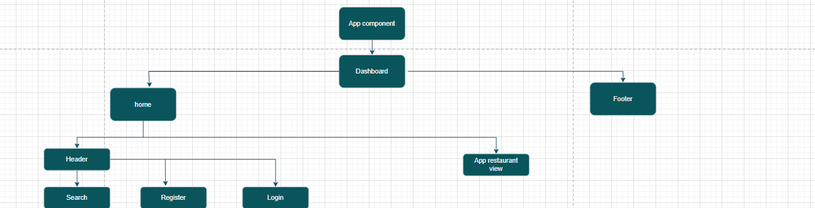
FRONT END FLOW

Slide 13
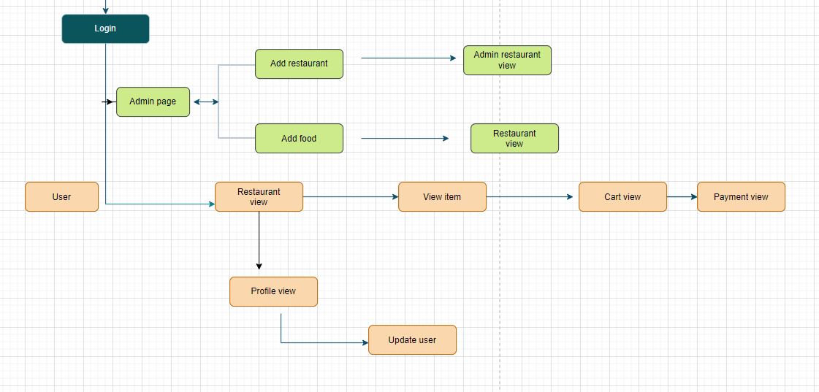
FLOW OF COMPONENTS (FRONT END)

Slide 14

FUTURE ENHANCEMENT
Intuitive Menu Display.
Real-Time Order Tracking.
Secure Payment Options.
Reviews.

Slide 15
BIBLIOGRAPHY
1. https://www.bezkoder.com/angular-10-jwt-auth
3.https://www.youtube.com/watch?v=d1MfY7MpX4c&list=PLdRq0mbeEBmwdwZF3lWwCcWmD76GfEFVT
2. https://youtu.be/855KrFfF9-w?si=qg7s0RBLWCawYPGq

Slide 16


​
Than

Slide 17

Thank You
​
Than

